Slide 1



Plants, Cognition, Time
(& Philosophy)
David Pierre Leibovitz
February 25, 2009

Slide 2






My Research
Time
  Relative scales of time and space
  Change, Processes, Motion
  Tradeoffs between Time & Cognition
    Not in plants but in what they can teach us
Emergic Behaviour
  Process vs. Substance
  Recurrence & Dynamic Systems
Meta Cognition / Philosophy of Mind (what is:)
  Thinking, Memory, Attention ...
Notes:
http://en.wikipedia.org/wiki/Cognition
http://en.wikipedia.org/wiki/Dynamical_system
http://en.wikipedia.org/wiki/Emergence
http://en.wikipedia.org/wiki/Philosophy_of_mind
http://en.wikipedia.org/wiki/Process_philosophy
http://en.wikipedia.org/wiki/Recurrence_relation
http://en.wikipedia.org/wiki/Recursion
http://en.wikipedia.org/wiki/Time

Slide 3




Why Plants?
Plants are ordinarily thought of as
  “Dumb” stimulus/response systems
However, by analyzing plant behaviour at
  differing time scales, and
  allowing for other complexities
  one can come to view Plants as smarter than we thought – as information processors!
What can plants teach us about cognition?
  Let’s take a computational approach
  After all, hardware (knock on wood) does not matter

Slide 4




Purpose
To entertain, inform, challenge & engage
Meta Cognition (Philosophy of Mind)
  What do we mean when we say...
Can plants:
  Process Information? Make Decisions? Plan? Compute? Think?
  Have Free Will?
  Sense? Perceive? Feel? Be Conscious?
  Learn? Have Memories? Represent? Know? Have Intentionality? Communicate?
How shall we clarify these terms for humans?

Slide 5





Plant Motion Categories
Tropism
  Directional
  Positive: towards stimulus
  Negative: away from stimulus
Nastic
  Non-Directional
  Triggered by stimulus
Rapid Plant Movement
  Triggered by stimulus
Circadian
  Internal/External stimulus
Notes:
http://en.wikipedia.org/wiki/Motility

Slide 6
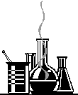






Tropism
Summary
  Directional movement or growth in response to stimuli
  Positive: towards stimulus
  Negative: away from stimulus
Tropism | Stimuli
Chemotropism | chemicals
Gravitropism | gravity
Hydrotropism | moisture or water
Heliotropism | sunlight (tracking)
Phototropism | lights or colors of light
Thermotropism | temperature
Thigmotropism | touch or contact
Notes:
http://en.wikipedia.org/wiki/Tropism
http://en.wikipedia.org/wiki/Chemotropism http://en.wikipedia.org/wiki/Chemical
http://en.wikipedia.org/wiki/Gravitropism http://en.wikipedia.org/wiki/Gravity
http://en.wikipedia.org/wiki/Hydrotropism http://en.wikipedia.org/wiki/Moisture http://en.wikipedia.org/wiki/Water
http://en.wikipedia.org/wiki/Heliotropism http://en.wikipedia.org/wiki/Sunlight
http://en.wikipedia.org/wiki/Phototropism http://en.wikipedia.org/wiki/Lights http://en.wikipedia.org/wiki/Color_spectrum
http://en.wikipedia.org/wiki/Thermotropism http://en.wikipedia.org/wiki/Temperature
http://en.wikipedia.org/wiki/Thigmotropism http://en.wikipedia.org/wiki/Somatic_sensation http://en.wiktionary.org/wiki/contact

Slide 7

Chemotropism
Movement or growth in response to chemicals
Likely the most significant tropism for all biological development
E.g., Pollen tube growth towards the ovules
  Nerve growth in animals
  Cellular differentiation due to chemical signalling?
Notes:
http://en.wikipedia.org/wiki/Chemical
http://en.wikipedia.org/wiki/Chemotropism
http://en.wikipedia.org/wiki/Pollen_tube
http://www.neurosci.tufts.edu/research_asst_profs/lovy_wheeler/alenka.html
http://en.wikipedia.org/wiki/Axon_guidance
http://en.wikipedia.org/wiki/Cellular_differentiation

Slide 8
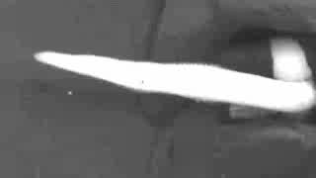
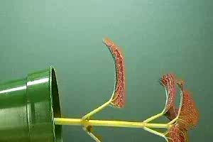
Gravitropism
  Movement or growth
  in response to gravity
    Positive Gravitropism
      Toward Stimulus
      Roots
      E.g., Corn Root
    Negative Gravitropism
      Away from Stimulus
      Shoots & Stems
      E.g., Coleus Shoot
Notes:
http://en.wikipedia.org/wiki/Gravitropism
http://en.wikipedia.org/wiki/Gravity
http://plantsinmotion.bio.indiana.edu/plantmotion/movements/tropism/gravitropism/rootgrav/graviroot.html
http://plantsinmotion.bio.indiana.edu/plantmotion/movements/tropism/gravitropism/coleus/coleusgravi.html

Slide 9
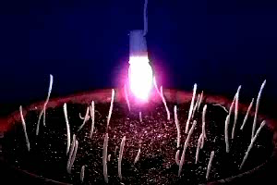

Phototropism
Movement or growth in response to lights or colours of light
E.g., corn phototropism + gravitropism
Decisions?
Free Will?
Notes:
http://plantsinmotion.bio.indiana.edu/plantmotion/movements/tropism/phototropism/corn/cornworship.html
http://en.wikipedia.org/wiki/Phototropism
http://en.wikipedia.org/wiki/Color_spectrum
http://en.wikipedia.org/wiki/Lights

Slide 10
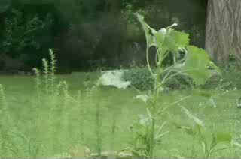

Heliotropism
Movement or growth in response to sunlight, specifically solar tracking
E.g. Young sunflowers tracking east to west
Circadian
control
“anticipates”
sunrise by
facing east
Memory?
Aboutness?
Notes:
http://en.wikipedia.org/wiki/Heliotropism
http://en.wikipedia.org/wiki/Sunlight
http://plantsinmotion.bio.indiana.edu/plantmotion/movements/tropism/solartrack/solartrack.html

Slide 11
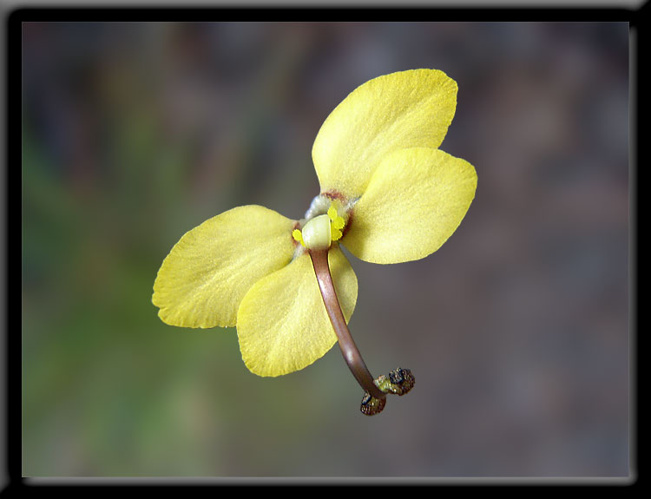

Thigmotropism
Movement or growth in response to touch or contact
Slow movement in vine growth shown later
Rapid movement in Donkey Trigger Plant
Notes:
http://www.gdaywa.com/wildflowers/triggerplants.php
http://en.wikipedia.org/wiki/Stylidium

Slide 12

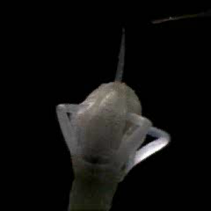
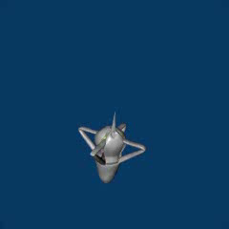
Pollen Ejection
Dogwood (Cornus canadensis)
  10,000 Frames Per Second
  2000 Gs
  4m/s
Smart Design, not Smart Execution
Notes:
http://www.williams.edu/Biology/explodingflower/movies.html
http://en.wikipedia.org/wiki/Cornus_canadensis
http://the-titan.deviantart.com/art/Trebuchet-90218221?moodonly=24

Slide 13


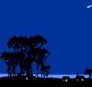
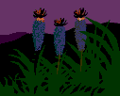

Nastic Movements
Summary
  Non-directional responses to stimuli
Nastic Movement | Stimuli
Chemonasty | chemicals
Gravinasty | gravity
Hydronasty | moisture or water
Nyctinasty | onset of darkness, circadian clock
Photonasty | lights or colors of light
Thermonasty | temperature
Thigmonasty | touch or contact
Notes:
http://en.wikipedia.org/wiki/Nastic_movements
http://en.wikipedia.org/wiki/Response
http://en.wikipedia.org/wiki/Stimulus_(physiology)
http://en.wikipedia.org/wiki/Nyctinasty
http://en.wikipedia.org/wiki/Circadian_clock
http://en.wikipedia.org/wiki/Thigmonasty

Slide 14

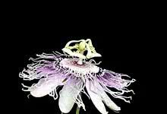
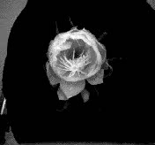
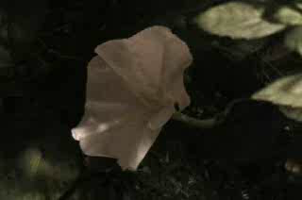
Photonasty
Non-directional response to
(colours of) lights
  Morning Glory (5am)
Often combined with
Circadian Clocks
  Passion flower (1pm)
  Moon Flower (6pm)
  Cereus (9pm)
Notes:
http://plantsinmotion.bio.indiana.edu/plantmotion/flowers/flower.html
http://en.wikipedia.org/wiki/Moon_Flower
http://en.wikipedia.org/wiki/Morning_glory
http://en.wikipedia.org/wiki/Nightblooming_cereus
http://en.wikipedia.org/wiki/Passion_flower

Slide 15
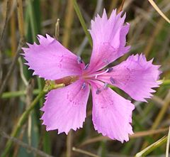
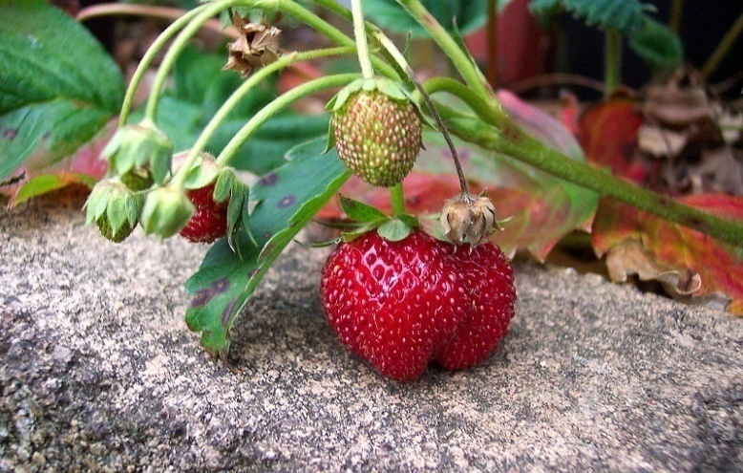
Photoperiodism
Sensing length of days (nights)
Used by some plants to decide
when to flower
  Long day plants (short nights),
  e.g., carnation
  Short day plants (long nights),
  e.g., strawberry
How computed?
  Remember time of night start vs. night end
  Combine with temperature
    What’s the difference between season start & end?
  Decision making, memory, representation?
Notes:
http://en.wikipedia.org/wiki/Photoperiod
http://en.wikipedia.org/wiki/Dianthus_caryophyllus
http://en.wikipedia.org/wiki/Long_day_plant

Slide 16
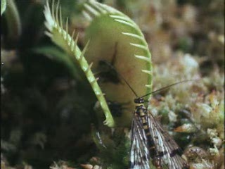
Thigmonasty
Touch
response
Smarter?
  Plant or
  Animal
Note: animal well inside before trap springs
Notes:
http://en.wikipedia.org/wiki/Thigmonasty

Slide 17

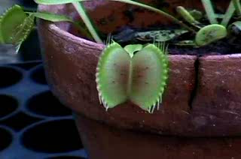


Venus Flytrap Counts to 2
Needs 2 critical touches
Computationalism?
Memory?
  Current Count
  Elapsed Time
Representation?
Aboutness?
Notes:
http://plantsinmotion.bio.indiana.edu/plantmotion/movements/nastic/flytrap/flytrap.html

Slide 18
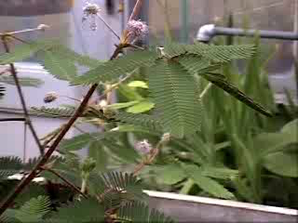

Thigmonasty - Mimosa
Two response
  Leaf closing
  Action Potential
    Information?
    Representation?
    Aboutness?
Sense?
  Perceive?
  Feel?
  Conscious?
Notes:
http://plantsinmotion.bio.indiana.edu/plantmotion/movements/nastic/mimosa/mimosa.html
http://en.wikipedia.org/wiki/Thigmonasty

Slide 19

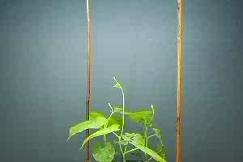
Nutation
Active Search
  Plan?
    Goal Seeking?
  Decision Making?
  Free Will
  Learning?
Nutation: bending motion due to unequal growth, e.g., twining of Morning Glory vines
When vine touches post, it’s tendrils curl around the post via a thigmotropic response (directed towards post)
Notes:
http://en.wikipedia.org/wiki/Nutation_in_plants
http://en.wikipedia.org/wiki/Thigmotropism
http://biology.kenyon.edu/edwards/project/steffan/b45sv.htm
Can be ten times more sensitive to touch than humans

Slide 20



Navigating Environmental Maze
Branches growing through gaps
  How to detect in windy locations?
Good soil exploited
  Bad soil avoided, rhizome thinned
  Growth accelerated to find richer patches
Roots avoid each other
  Likely by leaving chemical breadcrumbs/cookies
  An interaction with the environment
  Extended mind; Epistemic Structures (like ant pheromones)
Actively forage and explore
Notes:
http://aob.oxfordjournals.org/cgi/content/full/92/1/1
http://www.sce.carleton.ca/~schandra/web/research-theory.html
http://en.wikipedia.org/wiki/Ants
http://en.wikipedia.org/wiki/Extended_mind
http://en.wikipedia.org/wiki/HTTP_cookie
http://en.wikipedia.org/wiki/Pheromone

Slide 21


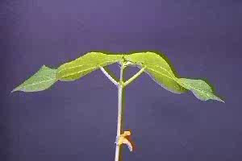


Circadian Rhythm
E.g., been leaf here, flowering elsewhere
Entrained by an exogenous (Zeitgeber) cue (light)
Endogenous process operates after stimuli removed
Learning? Memory? Intentionality?
Notes:
http://plantsinmotion.bio.indiana.edu/plantmotion/movements/leafmovements/bean/beansleep.html
http://en.wikipedia.org/wiki/Endogeny (internal)
http://en.wikipedia.org/wiki/Entrainment_(chronobiology) (phase/period alignment)
http://en.wikipedia.org/wiki/Exogenous (external)
http://en.wikipedia.org/wiki/Zeitgeber (time giver)

Slide 22
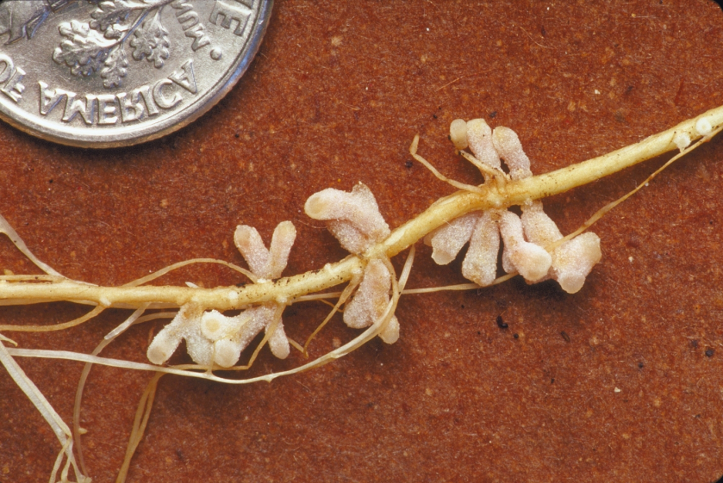

Plant Communication - Symbiants
A billion Rhizobia bacteria fix nitrogen in each root nodule of symbiotic legumes
  Rich set of interactive sign and symbol based two-way communication
  Biosemiotics: uses terms such as syntax, semantics and pragmatics but with different usage than linguistics. Nevertheless,
Can plants
  Understand, Know
  Have Intentionality?
  Young kids don’t?
Notes:
http://en.wikipedia.org/wiki/Bacterium
http://en.wikipedia.org/wiki/Communication#Plants_and_fungi
http://en.wikipedia.org/wiki/Biosemiotics
http://en.wikipedia.org/wiki/Legumes
http://en.wikipedia.org/wiki/Rhizobia
http://en.wikipedia.org/wiki/Root_nodule
http://en.wikipedia.org/wiki/Sign_(semiotics)
http://en.wikipedia.org/wiki/Symbiosis
http://en.wikipedia.org/wiki/Symbol
http://blog.lib.umn.edu/denis036/thisweekinevolution/2007/06/dinosaurfin_soup.html
More info:
http://www.sciencemag.org/sciext/plantvolatiles/

Slide 23




Plant-Plant Communication
Emits volatiles (“pheromones”) that warn other plants of herbivory attacks inducing their defences
  Also attracts herbivore predators & parasites
Notes:
http://en.wikipedia.org/wiki/Herbivory
http://en.wikipedia.org/wiki/Pheromones
http://en.wikipedia.org/wiki/Volatile
http://www.sciencemag.org/cgi/content/abstract/311/5762/812
http://www.plantphysiol.org/cgi/content/full/146/3/818#BIB42
http://www.pnas.org/content/104/13/5467.abstract

Slide 24


Plant Decision Making
Multiple Stimuli
  Gravitational and mechanical interactions
  Arabidopsis Root Waving
Will Overshoot/Undershoot
  But apply goal oriented error correction (hence cycles)
  Dynamic control system
Philosophy
  What is a decision?
  Can plants make decisions?
  Do plants have free will?
Notes:
http://aob.oxfordjournals.org/cgi/content/full/92/1/1
http://www.oeb.harvard.edu/faculty/holbrook/projects/arabidopsis/arabidopsis.htm
http://www.plantphysiol.org/cgi/content/full/135/3/1822

Slide 25


Plant Learning
Plants remember pre-treatments to mild water stress or cold even after stimuli removed
  Later on, they are more drought or cold resistant
What is memory?
  Representation?
Learn optimal stem thickening due to local wind sway conditions

Slide 26
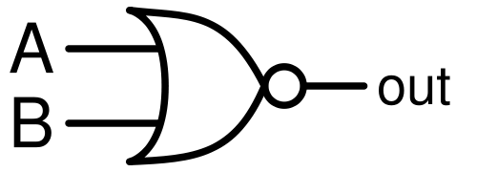
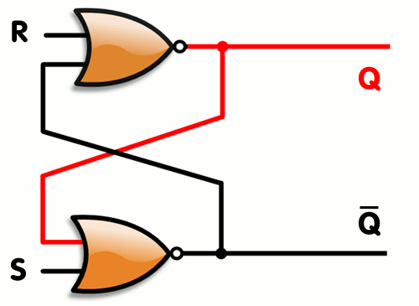
NOR Gate
The NOR gate is a pure Stimulus-Response element.
  It’s output is completely dependant on its current input.
  It has no memory
  Nevertheless, in a flip-flop design permanent memory emerges (much like in circadian rhythms)
  It is a universal gate and can be configured to implement any computer (Turing Machine)
  In other words, if the goal of cognitive science is a computational model of the mind, this can be completely expressed via NOR gates
  i.e., a human is nothing more than a configuration of NOR gates (really not much different than neurons)
Plants have much Stimulus-Response behaviour, but we have seen more complex patterns emerge as well.
Perhaps it is time to stop defining intelligence in terms of whether a life form is limited to SR behaviour or not.
Experimental paradigm tries to control for all factors and manipulate just one. At this point, internal strategies averaged away and you only see a response to a stimuli.
NOR Gate
A | B | out⁺
0 | 0 | 1
0 | 1 | 0
1 | 0 | 0
1 | 1 | 0
Flip-Flop
S | R | Q⁺
0 | 0 | Q (Memory)
0 | 1 | 0
1 | 0 | 1
1 | 1 | N/A
Notes:
http://en.wikipedia.org/wiki/Latch_(electronics)
http://en.wikipedia.org/wiki/Nor_gate

Slide 27
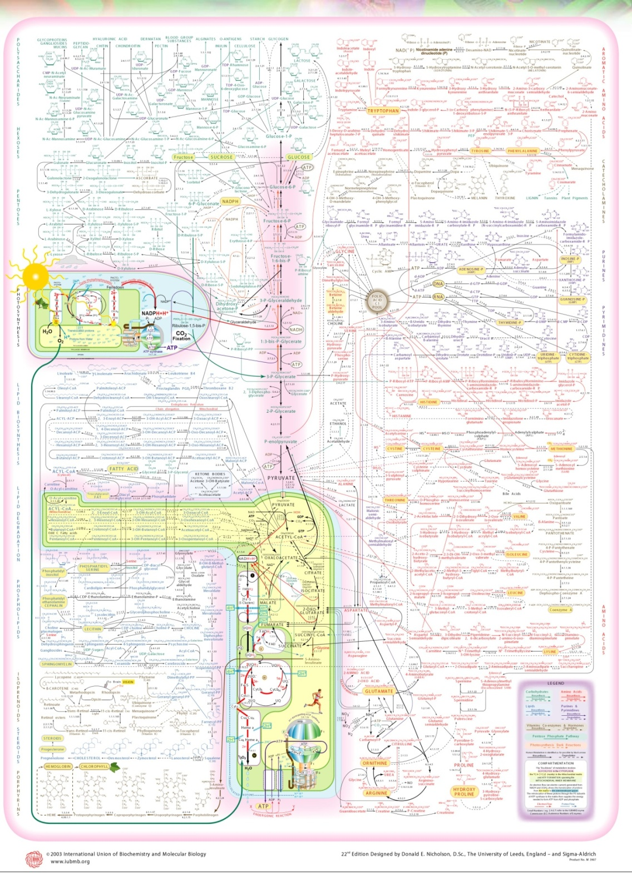
Metabolic Pathways
With numerous interacting processes, you end up with a computational system
Notes:
Nicholson, D. (2003) IUBMB-Sigma-Nicholson Metabolic Pathways Chart. 22nd edition. Sigma-Aldrich.

Slide 28
Prime References
The following sources have been greatly used in this presentation
  http://plantsinmotion.bio.indiana.edu
  Trewavas, A. (2003) Aspects of Plant Intelligence. Annals of Botany 92:1-20
  http://en.wikipedia.org
They and others are diligently annotated in the (hidden) notes.
  Just click on the hyperlink
Notes:
http://en.wikipedia.org/wiki/Hyperlink
http://plantsinmotion.bio.indiana.edu
http://en.wikipedia.org
http://aob.oxfordjournals.org/cgi/content/full/92/1/1

Slide 29
Questions
Are you more or less confused?
Too many animated icons?
  Imagine plants getting zillions of stimuli continuously and simultaneously. Don’t they have to be smart to process all that?
What have you learned?
My Research?

